Slide 1
Low Fidelity Prototyping
Week 8 (3/5/2016)

Slide 2
What is prototyping?
Prototyping is about creating a communication channel with customers, sharing ideas with stakeholders, and receiving feedback so that changes can be made early on in the development lifecycle.

Slide 3
What is a prototype?
In interaction design it can be (among other things):
a series of screen sketches
a storyboard, i.e. a cartoon-like series of scenes
a Powerpoint slide show
a video simulating the use of a system
a lump of wood (e.g. PalmPilot)
a cardboard mock-up
a piece of software with limited functionality written in the target language or in another language

Slide 4
Why prototype?
Evaluation and feedback are central to interaction design
Stakeholders can see, hold, interact with a prototype more easily than a document or a drawing
Team members can communicate effectively
You can test out ideas for yourself
It encourages reflection: very important aspect of design
Prototypes answer questions, and support designers in choosing between alternatives

Slide 5
What to prototype?
Technical issues
Work flow, task design
Screen layouts and information display
Difficult, controversial, critical areas

Slide 6
Low Fidelity Prototype
Raw depiction (often a white board drawing or sketch that outlines a particular piece of UI)
Does not look like the final product (uses paper, cardboard and not electronic screens)
Does not provide the same functionality (may perform limited set of functions, or may only represent the functions and not perform any of them).
Quick, cheap and easily changed (produce, modify to support exploration of alternative design and ideas)

Slide 7
An Example (creating website) using Balsamiq
Creating a prototype for a website (few steps)
Step 1: Create a MockUp of a Homepage
Step 2: Create a Subpage
Step 3: Click on the Button Bar to Edit it
Step 4: Add Links to Page Names in the Button Bar
Step 5: Save and View Your Prototype
Step 6: Click Your Prototype

Slide 8
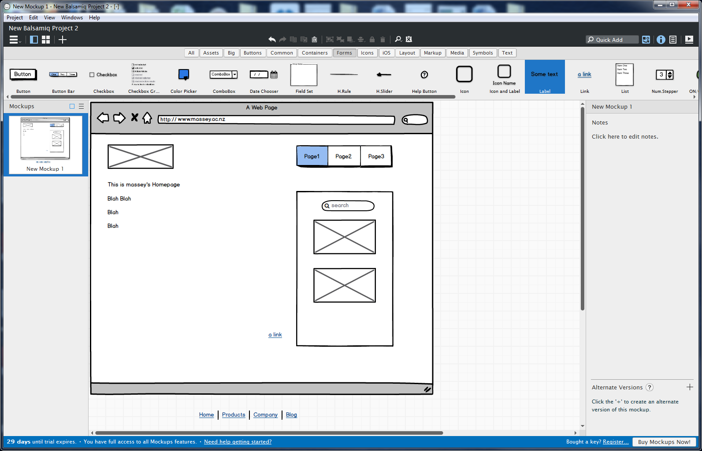
Step 1: Create a Mock Up of a Homepage – Ex website and add elements like rectangles, images and text boxes. Add a navigation bar to the page using button bar element. Add page names to your button bar by double-clicking on it and typing. Separate page names with commas. Example: “Page 1, Page 2, Page 3.”

Slide 9
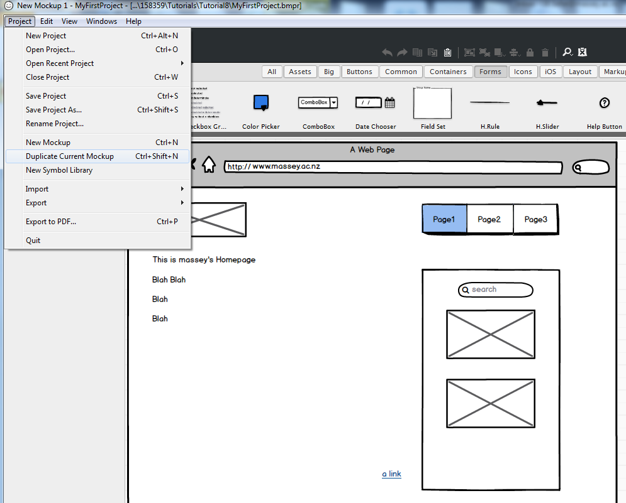
Step 2: Create a Subpage (from Main Menu, Project→Duplicate Current Mockup). Edit the duplicated page as a subpage.

Slide 10
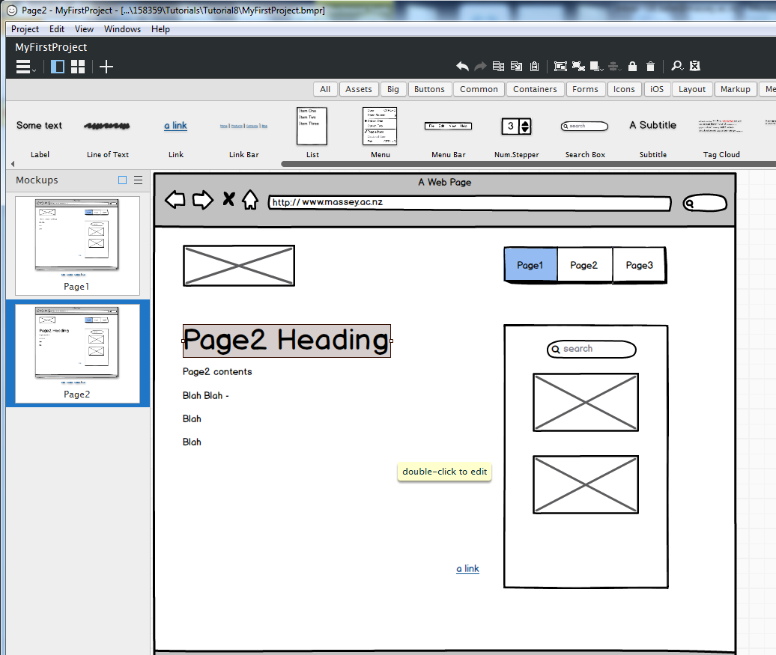
Step 2: Create a Subpage (contd.) Rename these appropriately (Page2) that corresponds to the page name in the button bar.

Slide 11
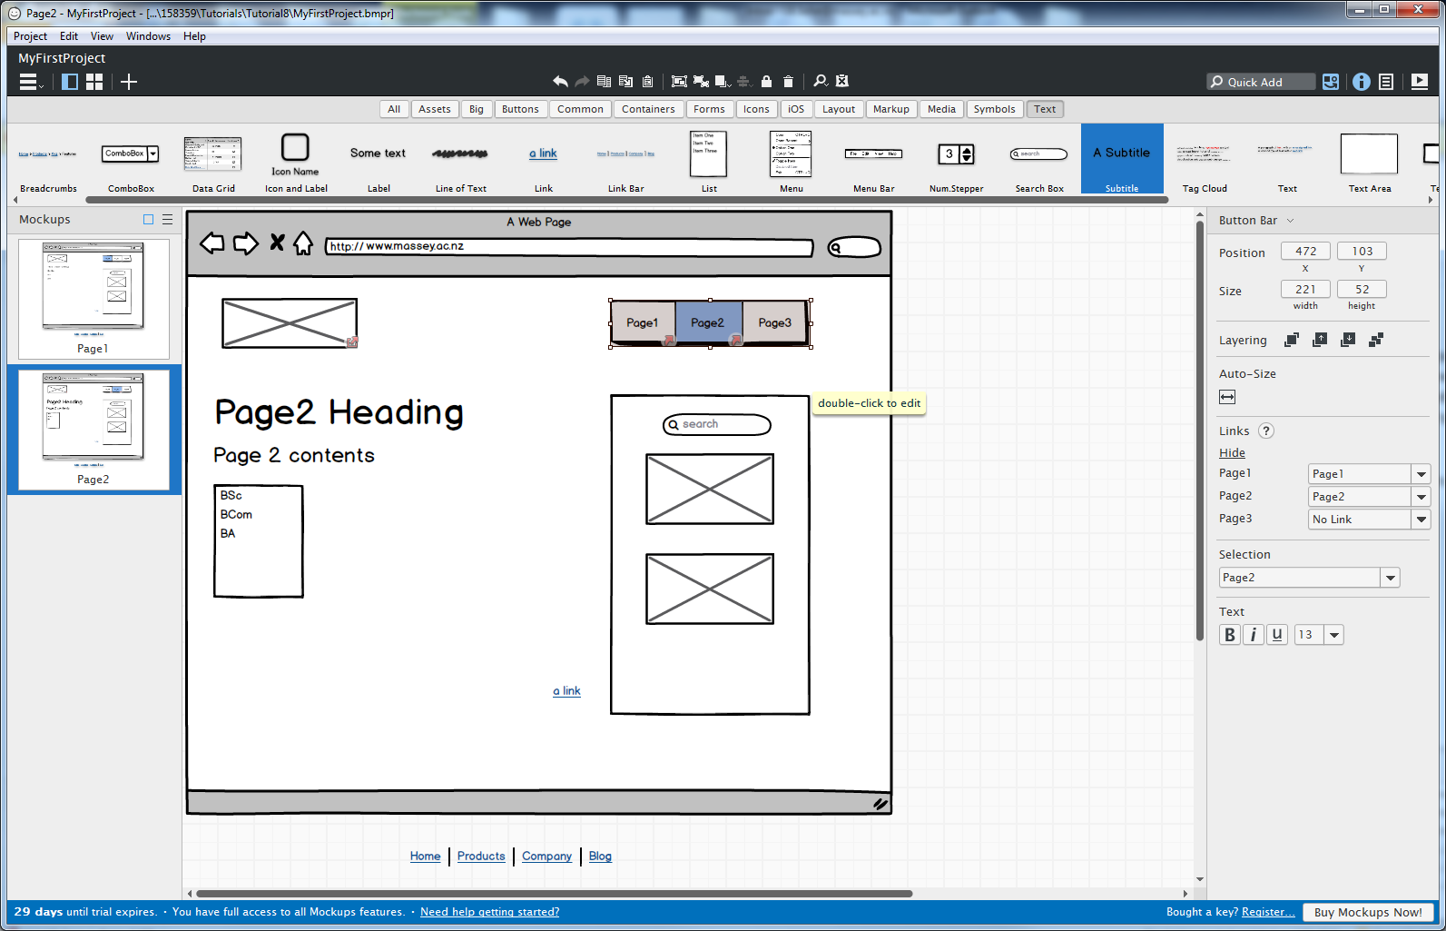
Step 3: Click on the Button Bar to Edit it

Slide 12
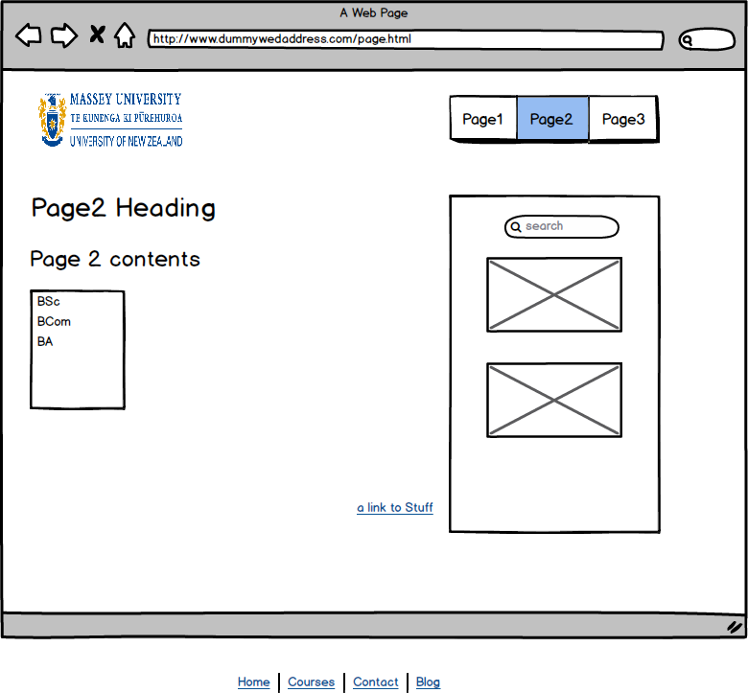
Step 4: Add Links to Page Names in the Button Bar and other links

Slide 13
Step 5: Save and View Your Prototype Project→Save, Save As..
Step 6: Click Your Prototype
View→Full Screen Presentation

